Slide 1


Minor Project
Title: Sorting Visualizer
Presented by:
R214220069 -Aditi Prasad
R2142201159-Somyansh Avasthi
R2142201479 -Ananya
R214220103-Agnibha Dutta Ray
Mentored By –
Dr. Amit Singh
School of Computer Science

Slide 2
Content
Introduction
Literature Review
Objectives
Methodology
Working Model
Results
Conclusion
References

Slide 3
Introduction –
Sorting visualizer
Our sorting visualizer is an application for visualizing of different sorting algorithms like selection sort, bubble sort, insertion sort, quick sort, etc with the functionality of (speed control) and (array size control) and also displaying the time complexity and applications of those sorting algorithms .
Sorting is a process in which data/items is arranged in an increasing or decreasing manner.
Our project is to sort the array and visualize the sorting process in a increasing manner .
Sorting visualizer helps visualize data with use of various sorting algorithms and use animations to show the sorting process.
The output will first show a non sorted array in the form of a bar graph , then it will visualize the process in which the array is being sorted by swapping the bar graph position according to the sorting algorithm .

Slide 4
Technical Concepts (Algorithms) used
- Used python 3.9 version for creating the project sorting visualizer and used python programming concepts for the coding .
- Used python libraries such as Tkinter, random, time, math
- Tkinter is the standard GUI library for Python.
- Random module is an in-built module of Python which is used to generate random numbers.
- Time module provides many ways of representing time in code, such as objects, numbers, and strings. It also provides functionality other than representing time, like waiting during code execution and measuring the efficiency of your code.
- Math is a built-in module that provides standard mathematical constants and functions.
- Used and visualized sorting of selection sort, insertion sort, bubble sort, quick sort, heap sort, cocktail sort,etc.

Slide 5
Motivation
We sort many things in our daily life such as medicine to eat, playing cards, etc.
Sorting is also an important aspect in performing computer tasks. We sort the database to make it easier for us to look at it and search for an item much easier.
Naturally there has been an intensive study of this topic and many algorithms have been devised for our preferred needs. Some algorithms are faster but unstable and some are slower but can sort a huge heap of data perfectly. It is necessary to choose the best algorithm for the required sorting as no one would use quicksort for sorting a database by date even though it is the most used algorithm in all computer programming languages.

Slide 6
Problem Statement
To sort the data or arrays using various sorting algorithms and then visualizing the results on the screen along with displaying the time complexities and applications of the sorting algorithms .

Slide 7
Area of application
1. Helps to learn and understand sorting algorithms better and easily .
2. We can sort the databases to make it easier for us to look at it and search for an item much easier.
3. Sorting can also be used for matching entries in lists .
4. We can also use this in the gaming sector like to create abacus ,sudoku, etc .
5. Sorting is widely used in the banking sector, teaching sector, the finance sector, e-commerce sector, etc.

Slide 8
Literature Review
Kerren and J. Stasko's paper "Algorithm Animation" provides a step-by-step tutorial for examining the environment, means, and the available coding techniques to apply a sorting animation. There are many various kinds of software that may be used for animation, and one of which is BALSA, which invented the intriguing event technique .
The paper “Do Algorithm Animations Assist Learning? An Empirical Study and Analysis” provides a thorough examination of student’s reactions and responses to sorting animation. It provides an in-depth view for it. In order to compare the outcomes of students who used solely textbook resources to those who also had access to animation and visualization for support, post-test research was conducted. Each student group took the identical post-test, which offered a thorough examination of the subject.
Stasko's "Using Student-Built Algorithm Animations as Learning Aids" is another article we came across. It firstly cited the identical error found in the previous article that it doesn’t benefit students that much. However, in an intriguing turn of events, students were given instructions to create the animations themselves, as opposed to using some previously created to aid with understanding. The visual programming tool Samba was explained to the students.
Timo Bingmann outlines his animation experiments using music to highlight the variations between each sorting method audibly.

Slide 9
SWOT analysis
Strengths -
It can cater the needs of the user on sorting the data easily and understand the sorting process with animations .
Weakness -
The user has to specify the parameters based on which the data needs to be sorted.
Opportunity -
We can use various artificial intelligence algorithms to enhance the project and make it decide on its own on which dataset which sorting algorithm can be performed to provide most optimized results.
Threat -
Dependency on the user as choosing the wrong parameters might result in accomplishing less optimal results.

Slide 10
Objective
Main Objective
- Based on the needs of the user, visualizing the data in a sorted format in the form of bar graphs.
Sub Objective
- Sorting of data by using different sorting algorithms with the functionality of (Speed Control) and (Array Size Control) .

Slide 11
Methodology
Reference Software model -
https://digitalcommons.ric.edu/cgi/viewcontent.cgi?article=1129&context=honors_projects
Steps –
Phase 1 - Requirement analysis
Phase 2 - Designing and development
Phase 3 - coding
Phase 4 - Testing
Phase 5 - Bringing of all the above phases together and putting them into practice .

Slide 12
Timeline -

Slide 13
Deliverable of each steps or phase
Phase 1 - Requirement analysis
Studied the concepts of Basic python programming, sorting visualizer and how it can sort of arrays and visualize of sorting process .
Phase 2 - Designing and development
Built a model and the algorithm was designed for it.
Algorithm analysis and implementation for this project.
Phase 3 - coding
Used python basic concepts, used libraries like tkinter, random python library, generated buttons, and created windows by using tkinter library and used animation function for visualization for sorting algorithms .
Phase 4 - Testing
the testing will be done with multiple inputs of data.

Slide 14
The steps for the proposed project are outlined below -
1.Taking inputs from user as normal input (random dataset) or creative input (getting data by the distance of the line) .
2. The dataset is converted into bar graph and is shown to the user .
3. User selects a sorting algorithm provided by the buttons to sort the dataset .
4. After selecting the sorting method, user can see and understand how that sorting is working and also there time complexities and applications displayed on the screen .
5. User can stop the program by selecting stop button Or press shuffle button if the user wants to see another sorting method .

Slide 15
Working Model
Requirement analysis (Link of SRS)
https://docs.google.com/document/d/1LfytdAzluEiyAgO1WWAyo90NGMYdK60vKB2KQoasNpo/edit?usp=sharing

Slide 16
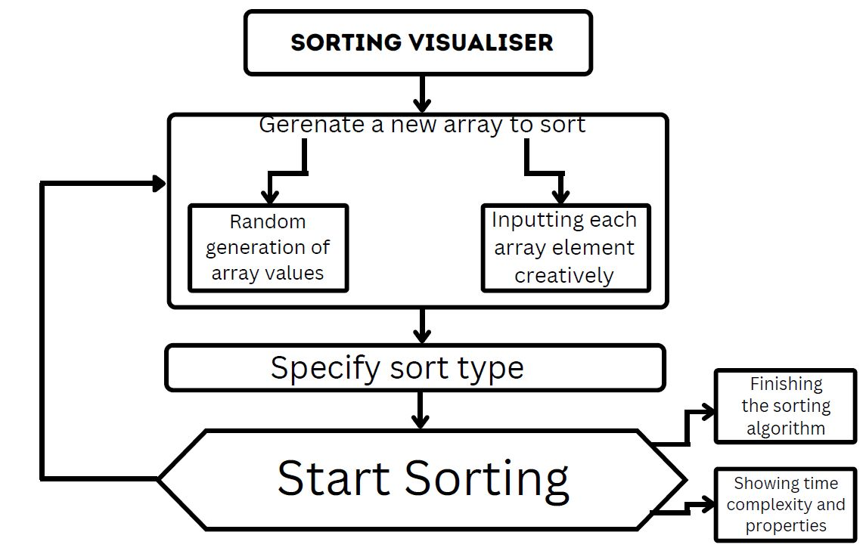
Technical Diagram

Slide 17
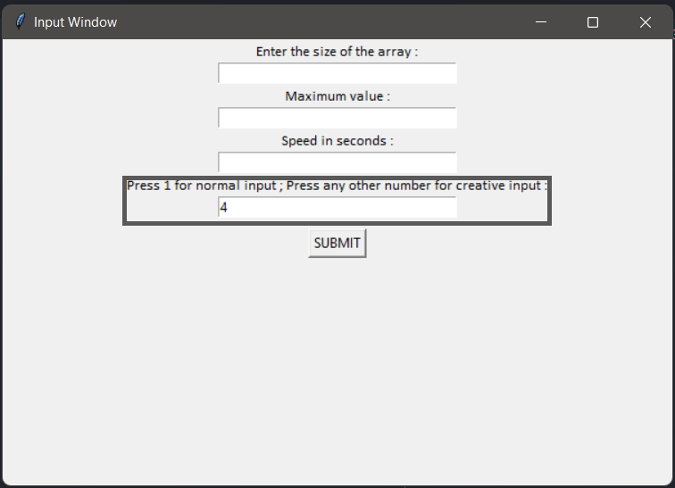
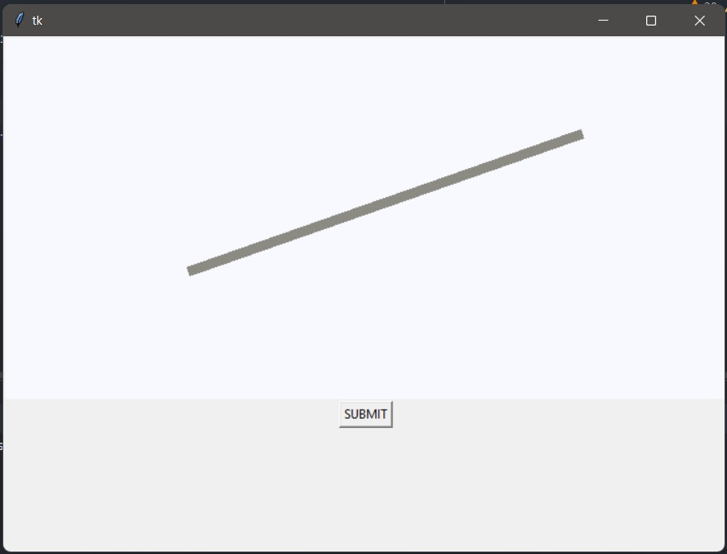
Working Module

Slide 18
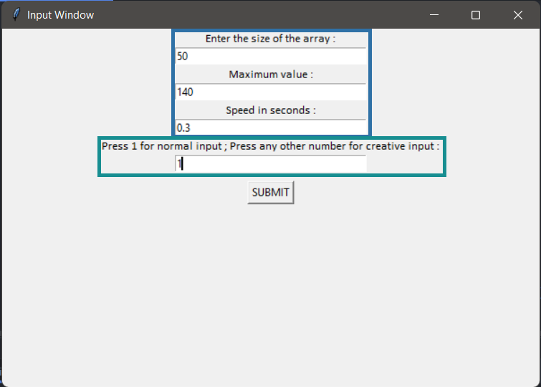

Slide 19
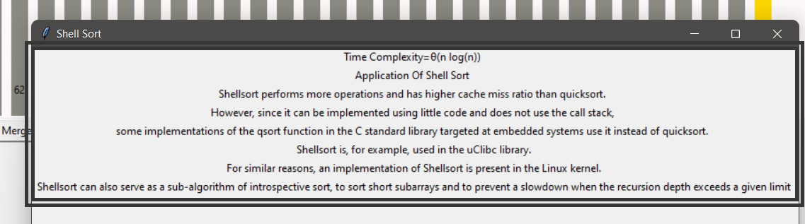
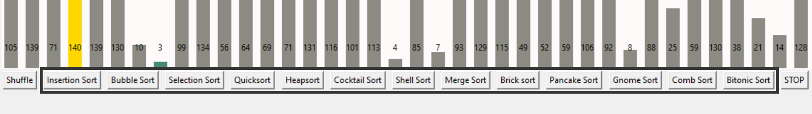
Results -

Slide 20
Conclusion
Justification of Objectives
This project can be used in various software domains which can be associated with banking sector, teaching sector, the finance sector, e-commerce sector, etc.
- It is making learning an algorithm much easier with visualizing it with animations and understanding its time complexity and applications .

Slide 21
Reference
[1] Sorting Visualiser dev community
[2] https://dl.acm.org/doi/10.1145/169059.169078
[3] https://digitalcommons.ric.edu/cgi/viewcontent.cgi?article=1129&context=honors_projects
[4] http://faculty.tamuc.edu/dcreider/csci520/Note520/Note%206.htm
[5]https://www.interviewkickstart.com/learn/time-complexities-of-all-sorting-algorithms#:~:text=a%20simplified%20form.-,Space%20Complexity%3A,complexity%20is%20O(1).
[6] https://panthema.net/2013/sound-of-sorting/
[7] https://dl.acm.org/doi/10.1145/169059.169078
[8] https://www.geeksforgeeks.org/time-complexities-of-all-sorting-algorithms/

Slide 22
Thank You

